Slide 1

2C11 - AIW Project
Fall 2014
Famous Paints Profile
Group 12
Ta Van Phuong
Do Thanh Tung
Nguyen Nhu Binh
Nguyen Manh Cong
Tran Manh Cuong

Slide 2
Agenda
Objectives
Product Overview
Product Features
Conclusion
Product Demonstration
Q & A

Slide 3
Objectives
To finish a real web that delivers the content to users.
Know how to use the web services and put them online for demonstration.
To be familiar with content management: collect, edit and publish an article collection of the most famous paints in the world with full information represented in Vietnamese.
To achieve more skills on English – Vietnamese translation.

Slide 4

Product Overview

Slide 5
Product Overview
Written in Ruby on Rails
Design using Bootstrap framework and a little customized style.css
Contains a simple backend to manage data - ActiveAdmin gem as the administration site
Uses MySQL as DBMS

Slide 6
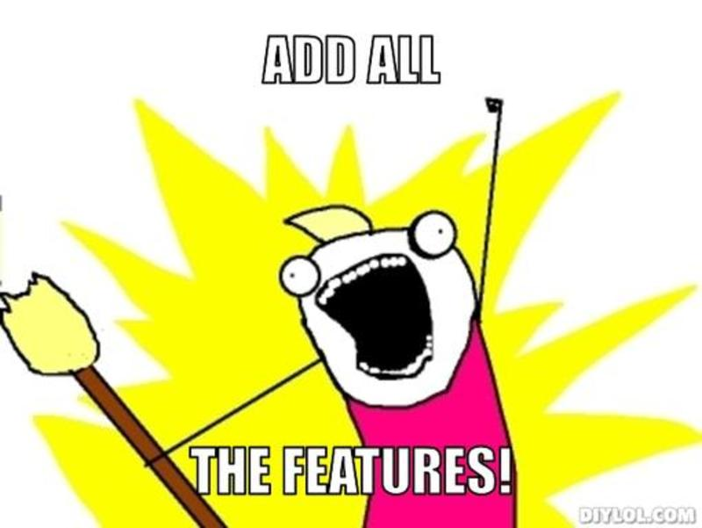
Product Features

Slide 7
Product Features
Associating Models and Application Administration
Integrating WYSIWYG editor
Uploading image with Carrierwave
Adding some basic validation
Some more customizations
Dynamic web title
HTTP Basic authentication
Pagination

Slide 8

Ruby on Rails

Slide 9
Ruby on Rails
Ruby
A scripting language
Yukihiro Matsumoto
Runs on various OSs
Ruby on Rails
Web application framework
Written in Ruby
David Heinemeier Hansson
Open source

Slide 10
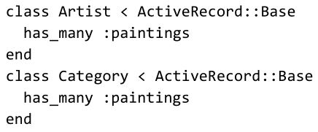
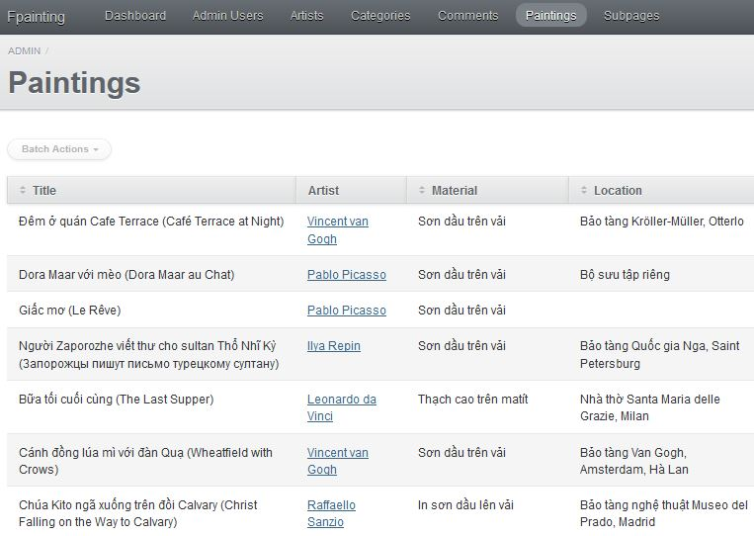
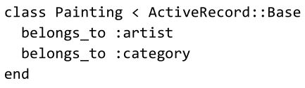
Ruby on Rails
ActiveAdmin
Associating Models
Application Administration

Slide 11
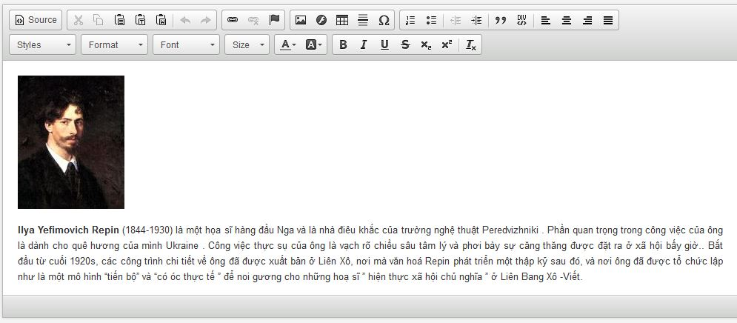
CKeditor
Open source HTML text editor
Compatible with Active Admin

Slide 12
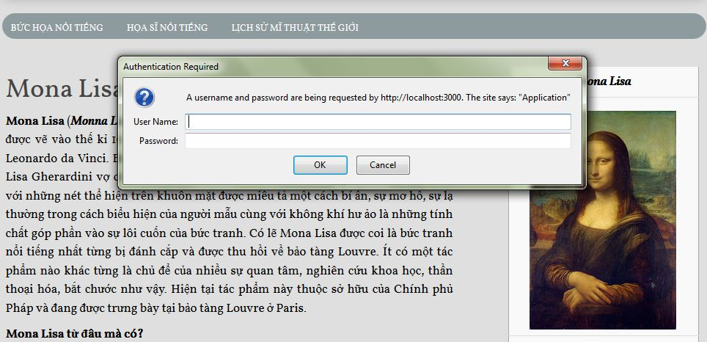

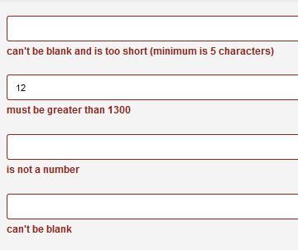
More features
Pagination
HTTP Authentication
Validation

Slide 13
Conclusion
Pros
Productive
Native English command
Has active community
Zillions of Ruby packages (“gem”)
Thousands of tutorials, screencasts and blog posts,…
Cons
Obsolete
Poor performance

Slide 14
Demonstration

Slide 15
Q & A – Interview
Thank you for attending with us!

